Slide 1
Module 6: Intellectual Properties, Rights and Data Privacy
Week 9

Slide 2
Overview
What is IP? And Different types of IPs?
Why IP is required?
Copyright
criteria for this IP? Items eligible for this IP
Unprotectable matter
Copyright law in Singapore
Exclusive Rights in Copyright and Overlapping Copyright
Duration of Copyright/ Owner of Copyright
Licensing and Assignment

Slide 3
Intellectual Properties (IPs) and Why it is required?
Legal rights protecting new creations – inventions, designs, music, books and many more as long as they in meet the eligible criteria.
IP law gives legal rights to IP creators, allowing them to control and exploit the use of their IP for a specific period of time.
Provides motivation for creators
Encourages constant creation and innovation
Allows creators to exploit their work for commercial gain
Allows creators to defend their work from infringement

Slide 4
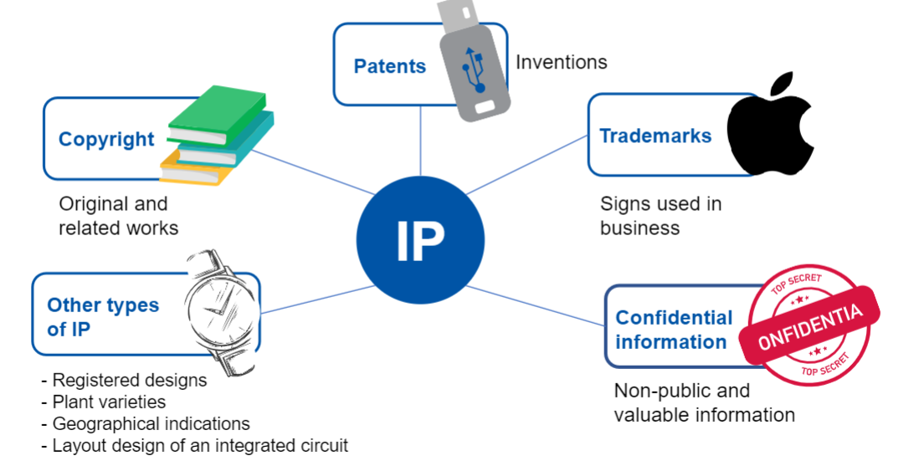
Different Types of IPs

Slide 5
Copyright
The right to prevent the unauthorised copying of others creations.
Gives bundle of exclusive rights to the copyright owner. And allows owners to enforce their rights against infringement.
Basic Criteria:
Falls within the categories of protection
Fixed in tangible form
Original – work was created independently by the author
Author/creator is a Citizen of that country or hold a valid eligible visa

Slide 6
Unprotectable Matter – Not eligible for copyright IP
Ideas and concepts
Discoveries
Procedures
Methods
Any subject matter that has not been reduced to a tangible form
Works in the public domain

Slide 7
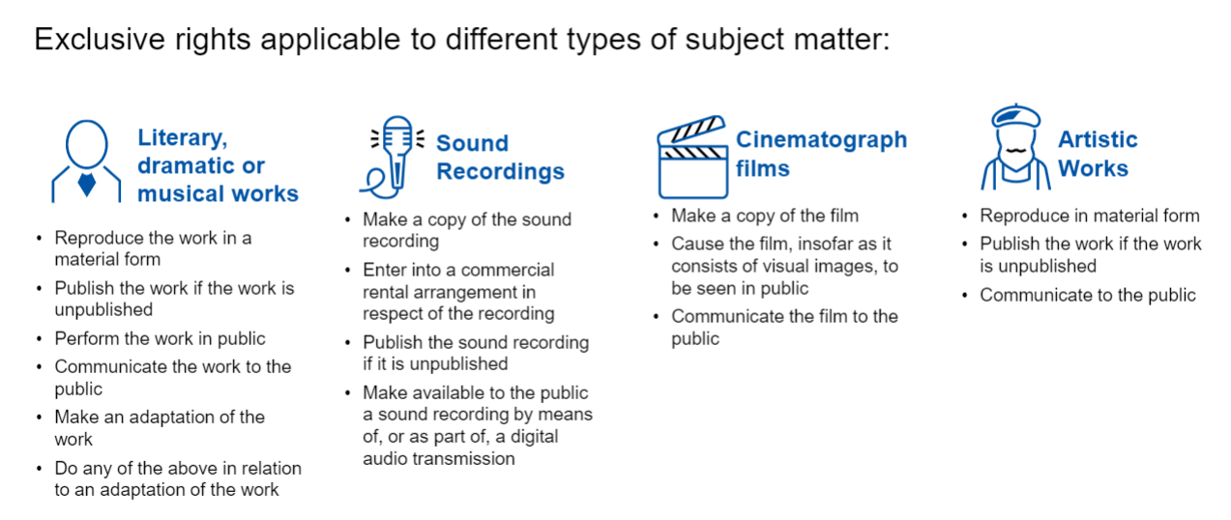
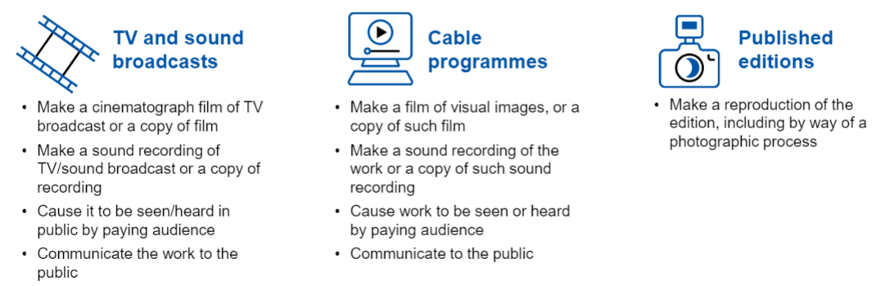
Exclusive Rights in Copyright

Slide 8
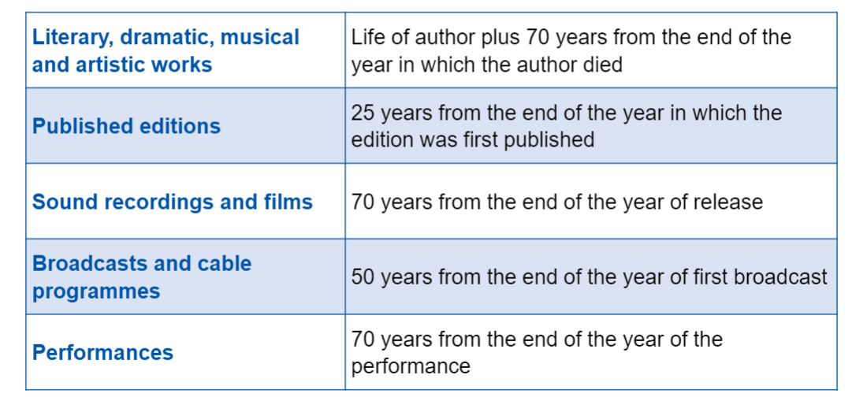
Duration of Protection

Slide 9
Dealing with IP
Licensing – a type of contract that gives permission to the holder/recipient to carry out a certain act, which would be infringing in nature otherwise.
Giving the owner the ability to use or exploit IP commercially, most commonly requiring a fee in return for the grant of the licence.
Assignment – another type of contract where the assignor (person making the assignment) transfers all entitlement and ownership rights that are the subject of the assignment to the assignee.

Slide 10
Module 6 Tutorial
Lesson Overview
In this week’s activity, students will learn the concepts of complying with different types of IP(s) during digital creation and solutioning, and rules of licenses for digital content.
Activity 1: What copyright protects.
Activity 2: Intellectual Property Rights in digital design.
Activity 3: IP Ownership and Dealing.
Activity 4: Licensing Matters.

